Slide 1

Upgrade your PowerApps Portal with PWA

Slide 2






Introduction
Oleksandr Olashyn
CRM Architect, 3SHAPE
https://www.dancingwithcrm.com/
https://www.linkedin.com/in/dancingwithcrm/
https://twitter.com/dancingwithcrm
https://github.com/OOlashyn

Slide 3
AGENDA
What is Power Apps Portal
What is Progressive Web App
PWA building blocks
Demo
QnA

Slide 4
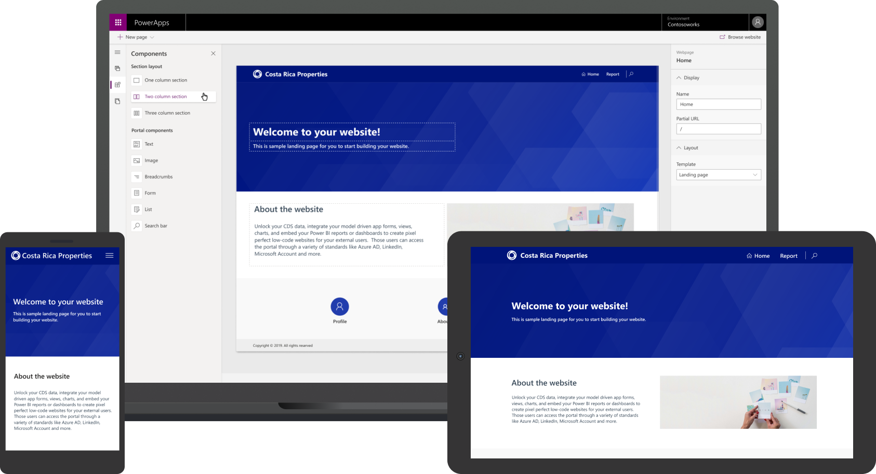
What is Power Apps Portal
Credit: Enable external access with Power Apps portals

Slide 5
What is Progressive Web App
“PWA are Websites that took all the right vitamins”
Google

Slide 6
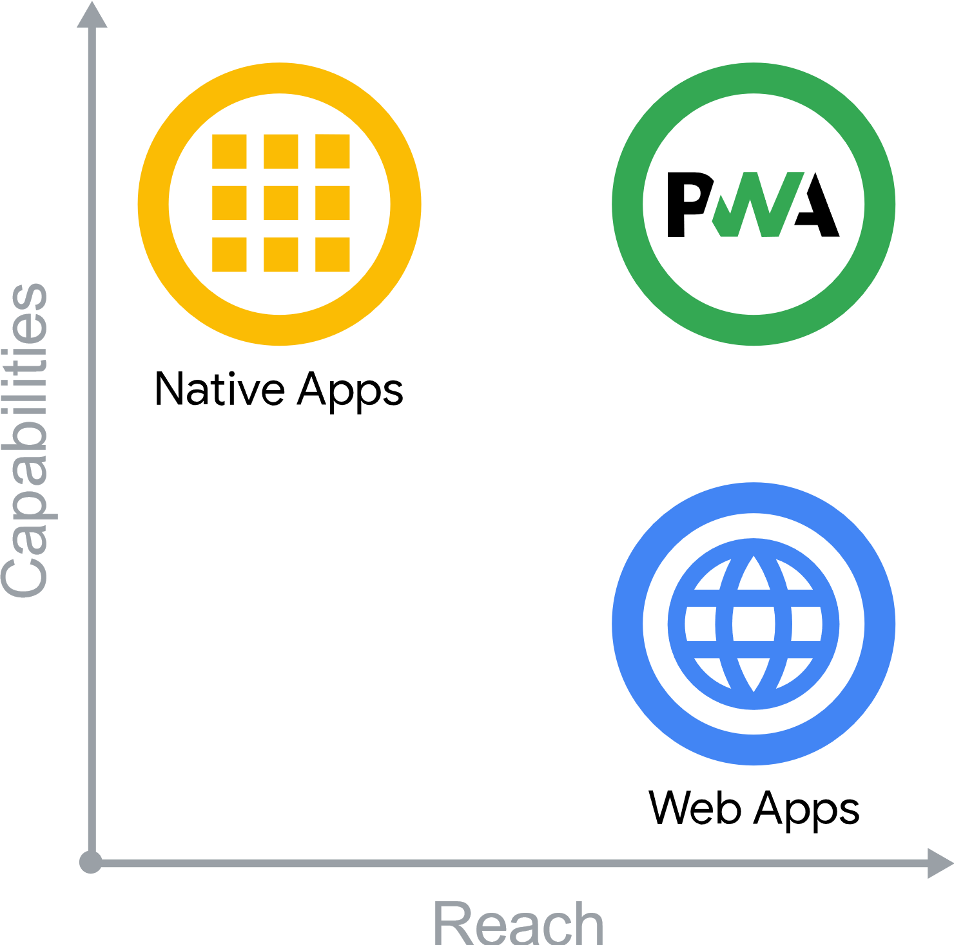
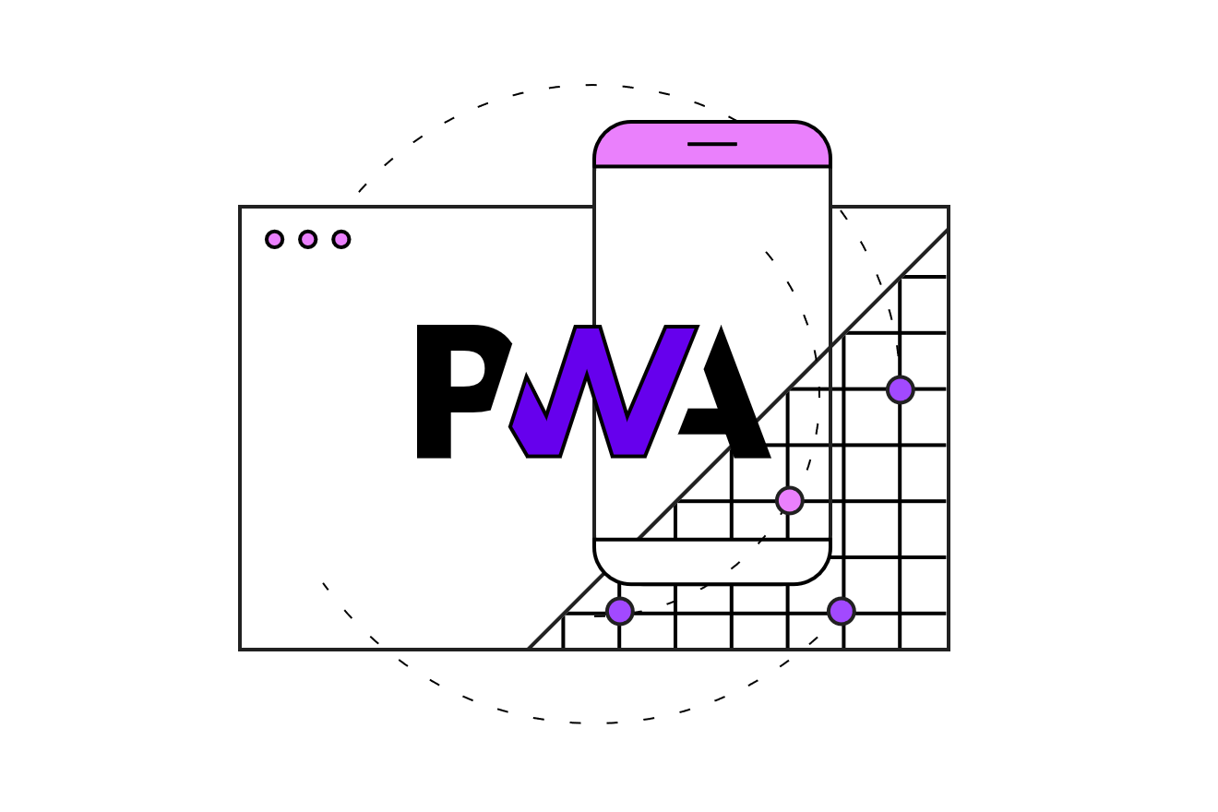
What is Progressive Web App
Credit: Web Dev – What are PWAs

Slide 7
What is Progressive Web App
Capable
Reliable
Installable
Fast

Slide 8
What is Progressive Web App
CAPABLE
Phone Notifications
Modern APIs
Offline

Slide 9
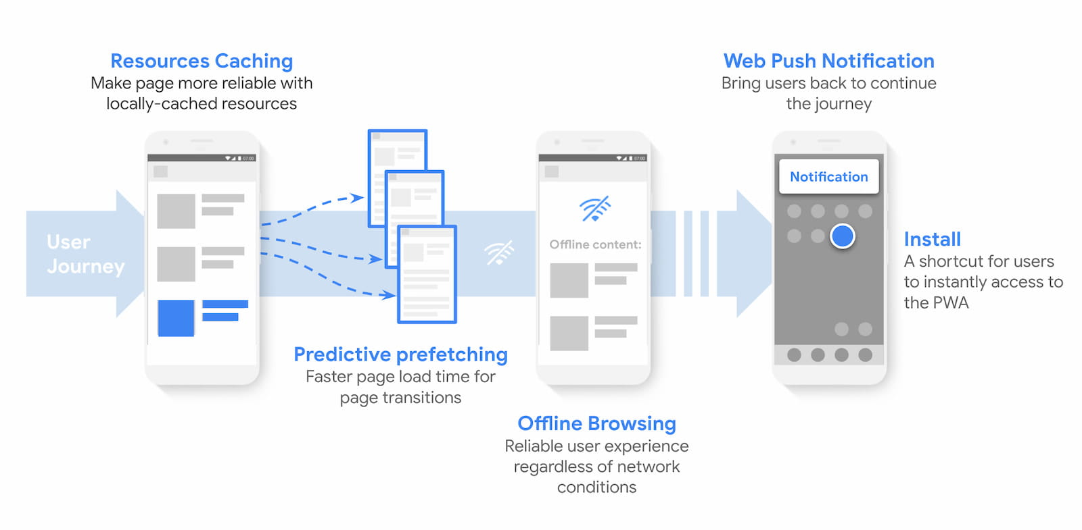
What is Progressive Web App
Credit: How Progressive Web Apps can drive business success

Slide 10
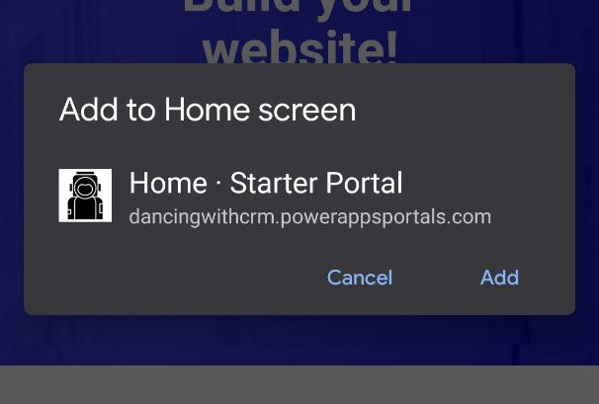
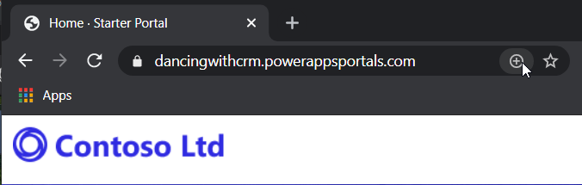
What is Progressive Web App
INSTALABLE
MOBILE
DESKTOP

Slide 11



What is Progressive Web App
Average size of installable app (in Mb)
11.5
37.9
0.35
Credit: Should You Develop A Progressive Web App?

Slide 12

What is Progressive Web App
TWITTER LITE
75% increase in Tweets send
20% decrease in bounce rate
65% increase in pages per session
Credit: 11 Examples of Progressive Web Apps

Slide 13
What is Progressive Web App
FORBES
43% increase in sessions per user
20% increase in impressions per page
6x increase in the number of readers completing articles
Credit: 11 Examples of Progressive Web Apps

Slide 14

What is Progressive Web App
PINTEREST
40% increase in time spent
65% increase in pages per session
50% increase in ad click-throughs
Credit: 11 Examples of Progressive Web Apps

Slide 15
PWA building blocks
Web App Manifest
Service Worker

Slide 16
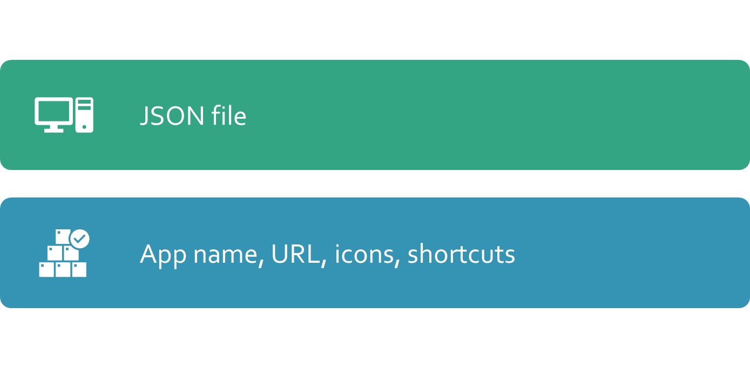
PWA building blocks
WEB MANIFEST

Slide 17
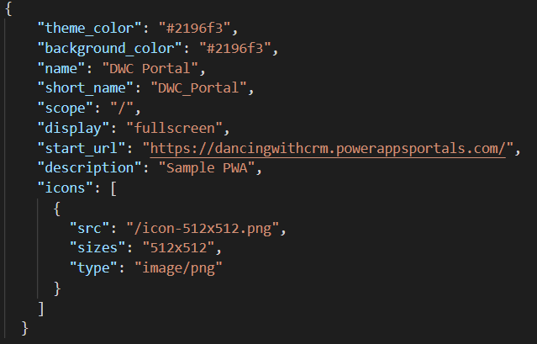
PWA building blocks
WEB MANIFEST

Slide 18
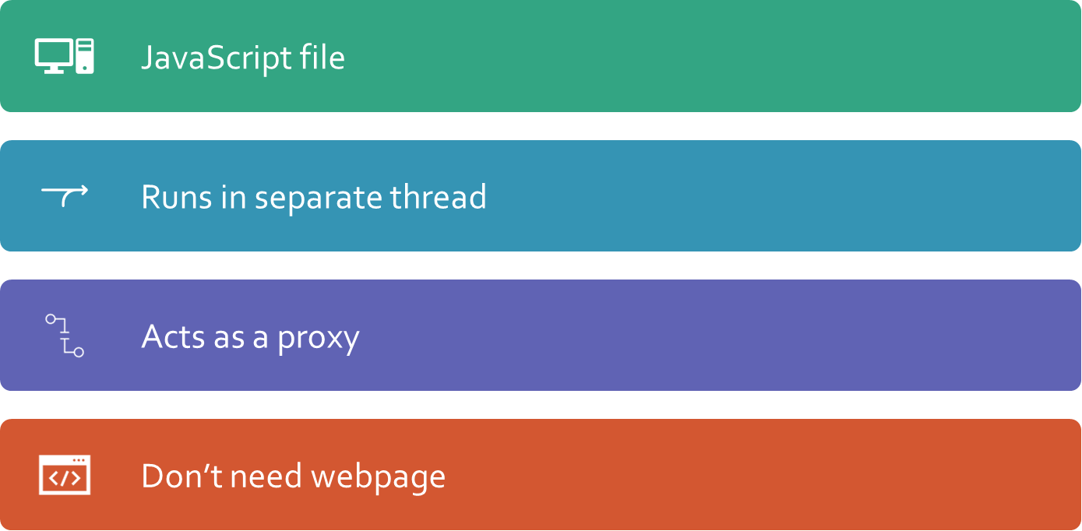
PWA building blocks
SERVICE WORKER

Slide 19






PWA building blocks
Cache
SERVICE WORKER
5
2
4
1
3
Page
Service Worker
Network

Slide 20

PWA building blocks
SERVICE WORKER
WORKBOX
PWA Builder

Slide 21
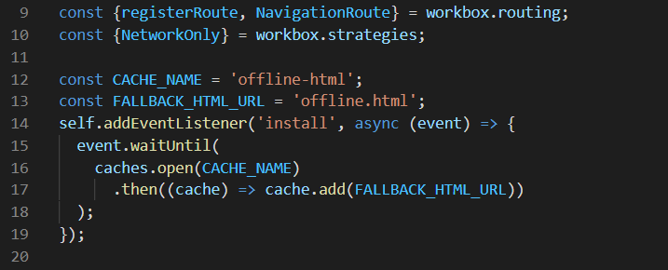
PWA building blocks
SERVICE WORKER

Slide 22
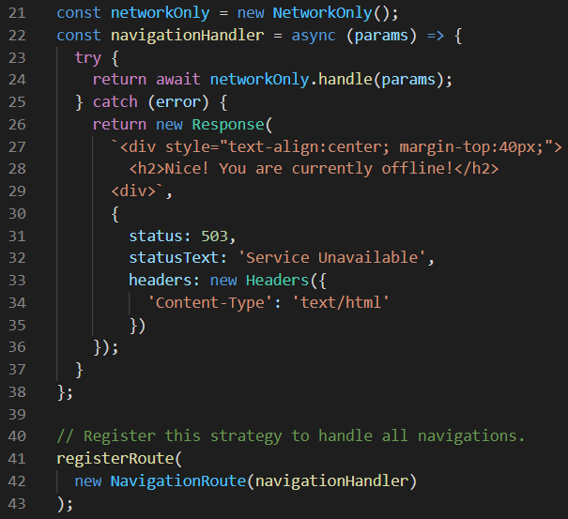
PWA building blocks
SERVICE WORKER
Upgrade your PowerApps Portal with PWA

Slide 23
DEMO

Slide 24
Links
Demo and presentation: https://bit.ly/3gUhUQg
What are PWA? : https://web.dev/what-are-pwas/
PWA Builder: https://www.pwabuilder.com/
Workbox: https://developers.google.com/web/tools/workbox
11 Examples of Progressive Web Apps: https://medium.com/@the_manifest/11-examples-of-progressive-web-apps-944f6db25a5a
How Progressive Web Apps can drive business success: https://web.dev/drive-business-success/

Slide 25

THANK YOU!
Fill out survey: https://bit.ly/32US5up

